Slide 1

Negative Balance Report
For overpaid claims recovered through offset
Notes:
“Welcome. In this training, we’ll walk through the Negative Balance Report, also referred to as the NBR.
The Negative Balance Report is designed to help you understand how overpaid claims are resolved through payment offsets.
It shows when an overpayment has already been recovered and links that activity to the claim used to fund the offset.
We’ll start with a brief overview of what the report shows and why it’s important, then walk through where to find it on the CignaforHCP.com portal and how to review the details.
We’ll also show you how to navigate between overpaid claims and funding claims, so you can quickly access patient and payment information without needing to search multiple areas of the portal.
By the end of this training, you’ll know how to use the Negative Balance Report to support accurate reconciliation and confirm that an overpayment has already been resolved or is still outstanding.”

Slide 2
Negative Balance Report
Overview
Portal entitlements
Where to find the report
Report page layout
Downloading the report
Navigating to the overpaid claim details
Linking overpaid claims to funding claim details
Summary and key takeaways
Notes:
What the NBR shows – Overpayments already recovered through payment offsets
Access requirements – Portal entitlement needed to view the report
Finding the report – Where the NBR lives on the portal
Reviewing results – How to read, filter, and interpret the report
Downloading the report – CSV download and availability timeframe
Claim navigation – Move between overpaid and funding claims
Key takeaways – How the NBR supports reconciliation and reduces research

Slide 3

Overview
Notes:
“This overview explains what the Negative Balance Report shows and why it is used, then walks through how to access and review it on the portal.”

Slide 4
Negative Balance Report
Reconcile overpayments recovered through payment offsets
What the Negative Balance Report (NBR) shows
Overpaid claims that have been recovered through payment offsets or manual check.
The amount recovered and the claims(s) used to fund the offset.
Results searchable primary by Tax Identification Number (TIN).
Why this Matters
Supports accurate accounts receivable reconciliation.
Clearly links overpaid claims to the funding claim(s) used to offset them.
Reduces manual research across multiple claim records.
Key Features Identifies overpaid claims and offset amounts. Search by TIN, with optional refinement by claim number and date of service (up to two years). Provides direct links to overpaid and funding claims (claim detail patient and payment pages). Enables bidirectional navigation between overpaid and funding claims. Downloadable CSV report, available for 30 days on the Cigna for Health Care Professionals portal (CignaforHCP.com).
Notes:
“The Negative Balance Report is designed to make it easier to understand how overpayments are resolved through payment offsets.
The report identifies overpaid claims that have already been fully or partially recovered. It shows the offsets and check payments applied and any remaining balance, so you can confirm whether anything is still owed.
You can search the report using your Tax Identification Number, and if needed, further narrow results by claim number or date of service, going back up to two years.
The report also provides direct links to both the overpaid claim and the funding claim. These links allow you to view patient and payment details without needing to search multiple areas of the portal.
From either claim, you can navigate back and forth between the overpaid and funding claims. This bi‑directional navigation supports research and reconciliation without duplicating work.
Finally, the report can be downloaded as a CSV file, which remains available on the portal for 30 days. This is helpful for offline review or internal reconciliation processes.”

Slide 5
Portal entitlements
Notes:
“Next, review the portal entitlements required to access the Negative Balance Report and where to confirm that access.”

Slide 6
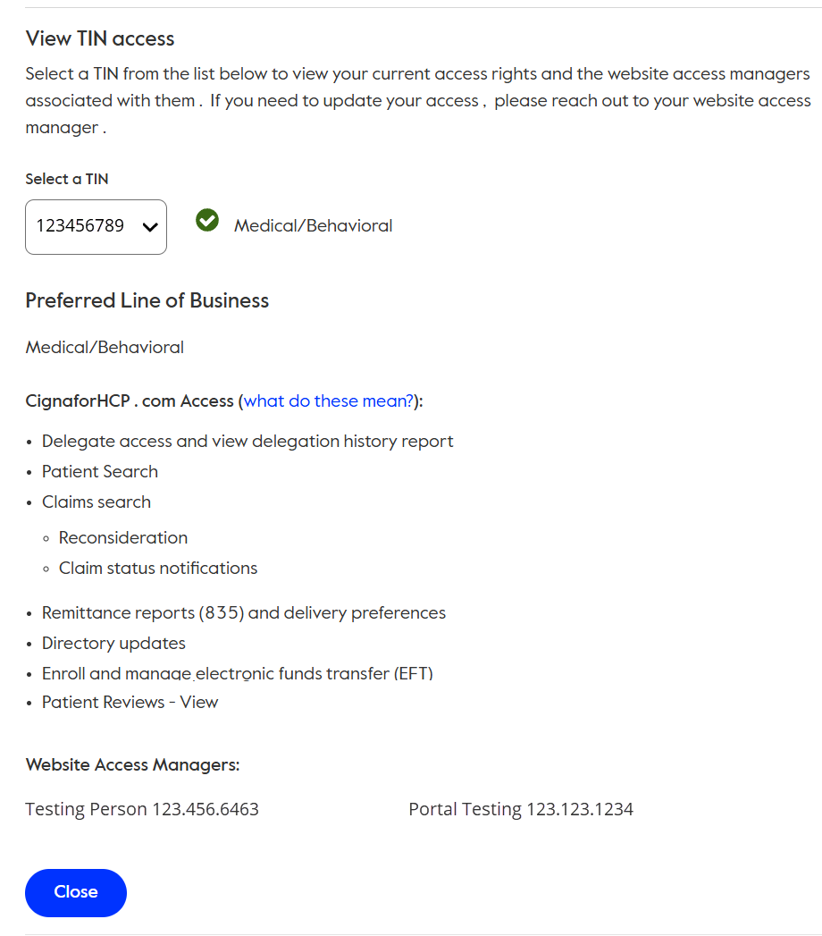
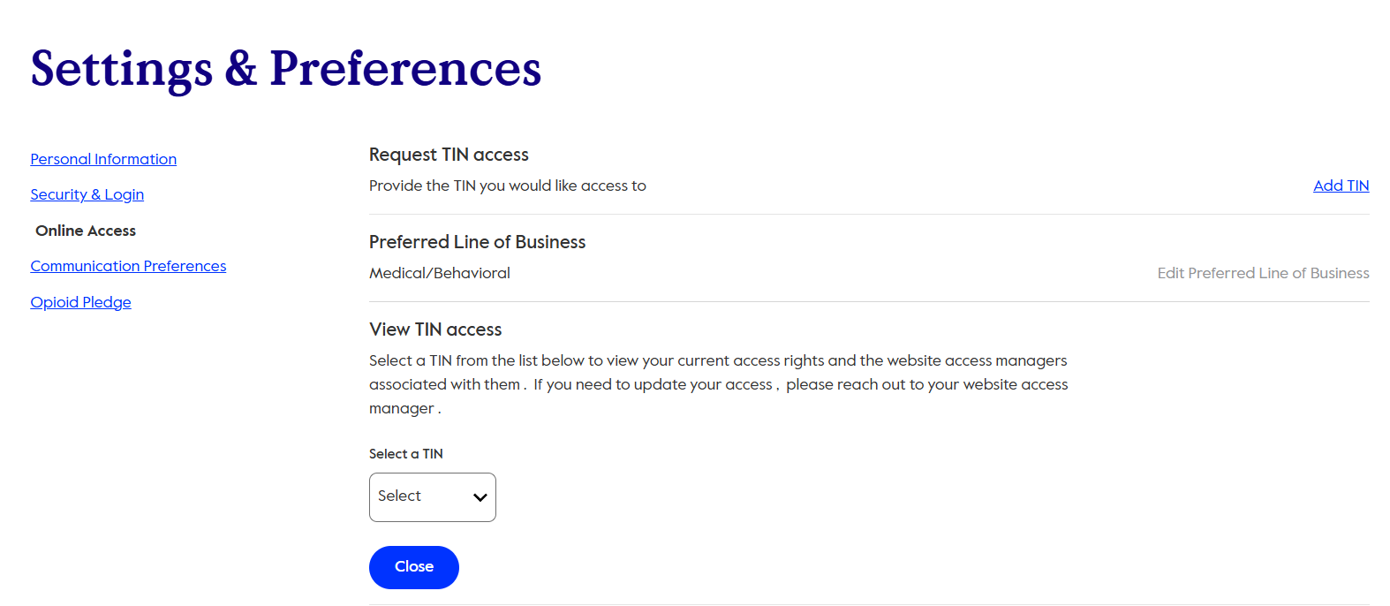
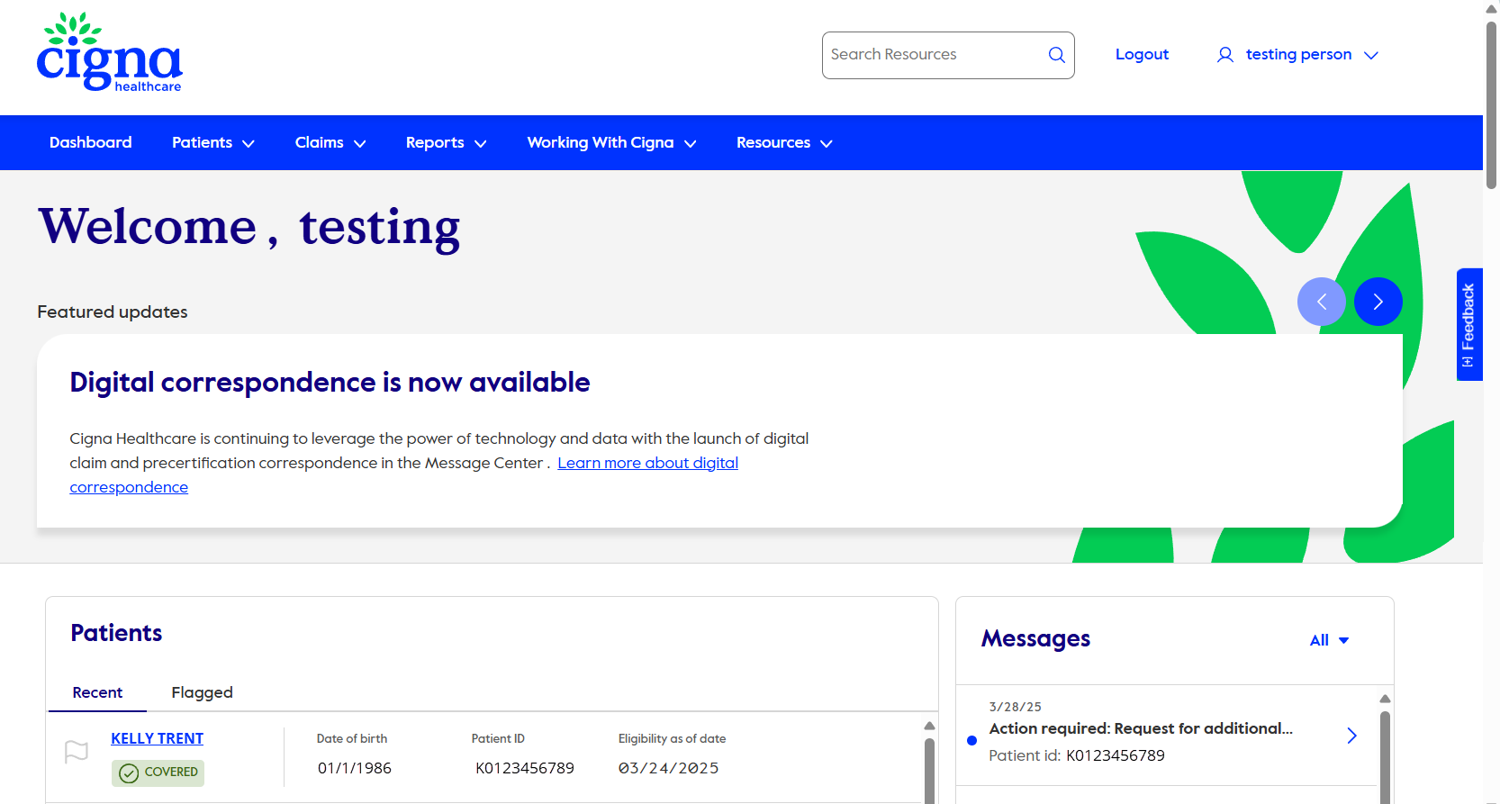
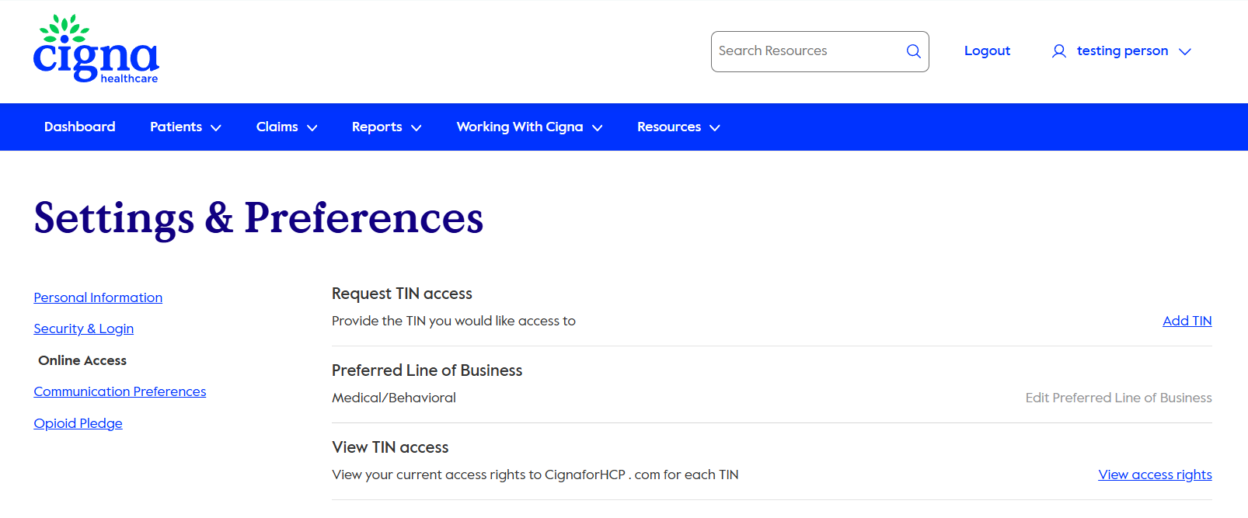
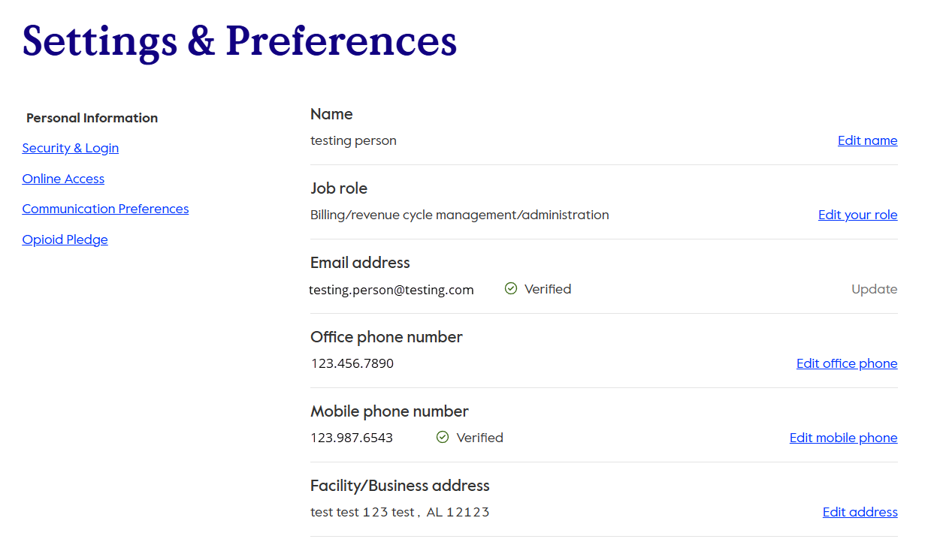
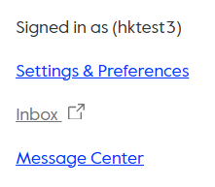
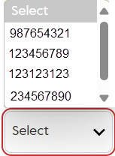
Entitlements
(Tester2)
Notes:
“To confirm you have entitlement for the Negative Balance Report, start in the top right‑hand corner of the portal and hover over your name and a dropdown menu will appear.”
“From the dropdown, select Settings and Preferences, then choose Online Access.”
“You will see View TIN Access and click View Access Rights.”
“From the dropdown select the TIN you want to review—your entitlements will automatically populate on the screen.”
“If you see Claim Search listed, you have the entitlement needed to view the Negative Balance Report.”
“If Claim Search is not listed, below your entitlements you will find the Website Access Managers, including their phone numbers.”
“You can contact one of the listed managers to request that the Claim Search entitlement be added to your access.”

Slide 7

Where to find the report
Notes:
“Now that we understand what the Negative Balance Report shows, let’s take a quick look at where to find it on the portal.”

Slide 8
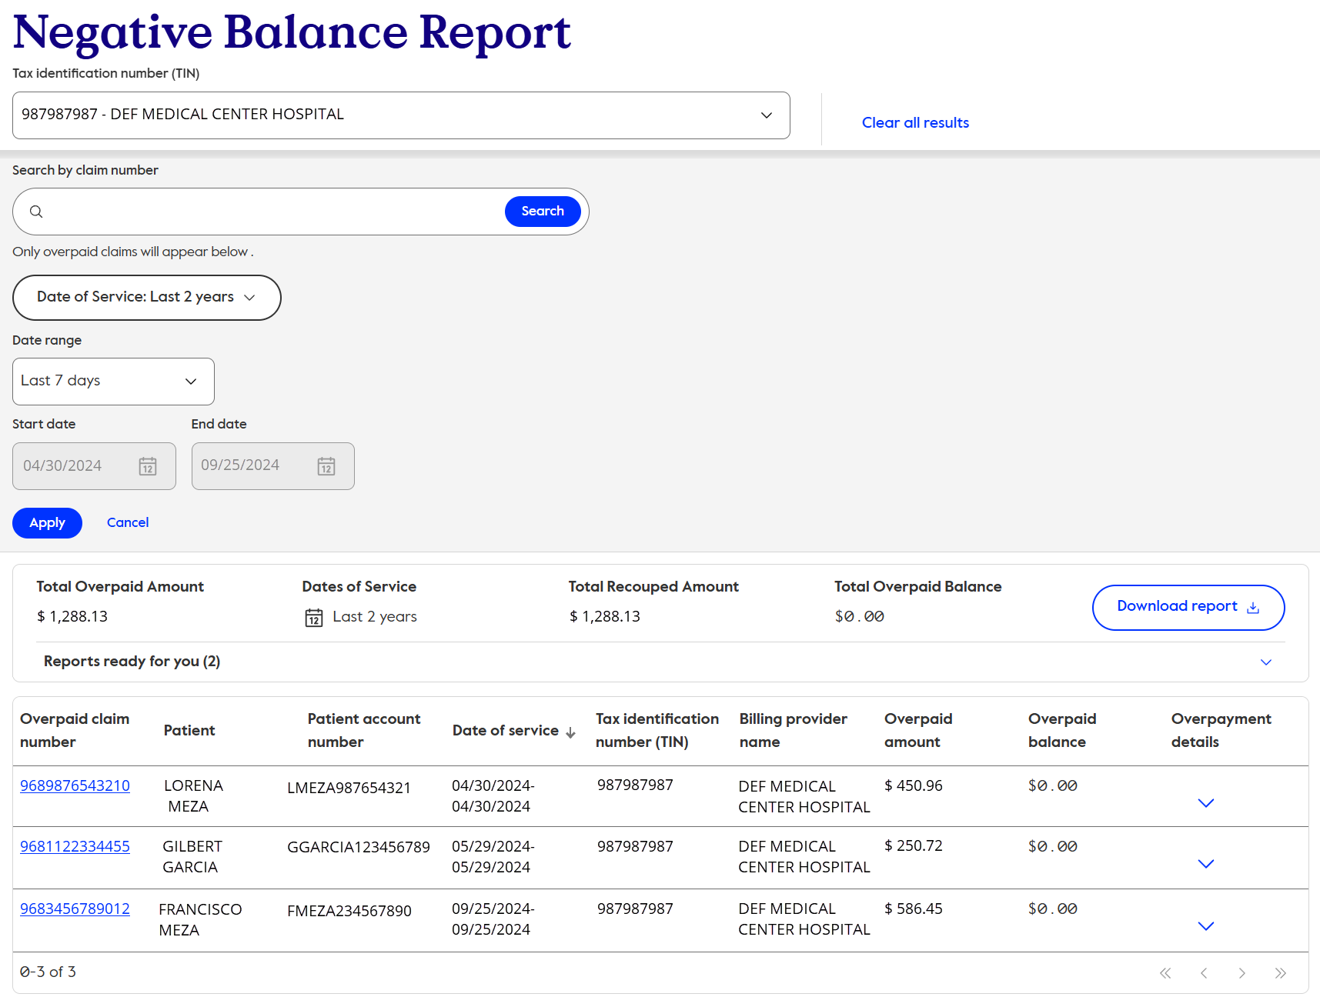
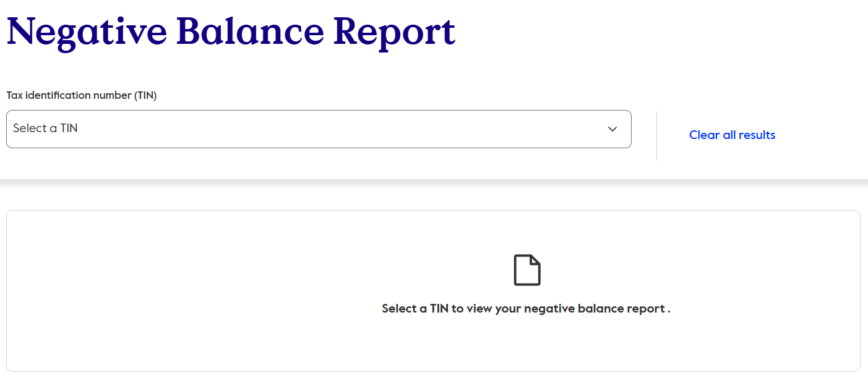
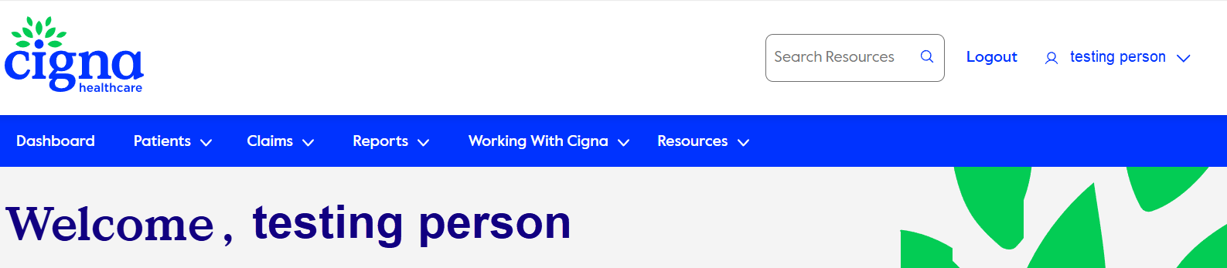
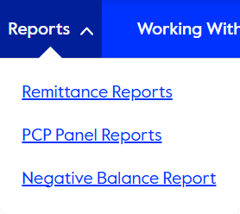
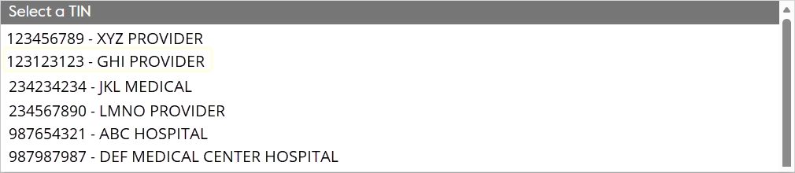
Report location
The report is located on the Reports page.
Notes:
“The Negative Balance Report is accessed from the Reports page on the portal.”
“From the Reports page, select Negative Balance Report to open the report.” “To begin your search, click the downward‑facing caret in the TIN field to display the list of available TINs.”
“Select the TIN you want to review for overpayment offsets.”
“Once a TIN is selected, the report will display results associated with that TIN.”
“This page serves as the starting point for reviewing overpayments that have already been recovered through payment offsets, which we’ll explore in more detail next.”

Slide 9
Report page layout
Notes:
“Next, we’ll review the layout of the Negative Balance Report page, so you know where to find key information and how to navigate results efficiently.”

Slide 10
Reviewing the report page
Refine results by date of service
Use Cigna Healthcare’s claim number to further refine results
Click here to download the NBR report
View the amount recovered
View the total overpayments identified for this TIN
Click to view funding claim details or refunds received
Click to open the overpaid claim’s patient and payment detail page
Notes:
“You can search using Cigna claim number, which is helpful when you’re researching a specific overpayment.”
“You can then refine results by the date of service of the overpaid claim to narrow the timeframe you’re reviewing.”
“It’s important to note that only overpaid claims appear on this report.”
“Use this option to clear your current search results if you want to start a new search or change criteria.”
“This total gives you a quick snapshot of the full overpayment activity for the selected TIN, helping you understand the overall scope of offsets included in your results and supporting efficient reconciliation.”
“This total shows the amount recouped through payment offsets and manual checks for the selected results, helping you quickly confirm that overpayments have already been recovered or are still outstanding.”
Click to view overpaid claim information, including recouped amounts or manual check payments received.
“Click downward facing caret to open up the overpayment details for this report.
“Finally, select this option to download the NBR report for offline review or reconciliation.”

Slide 11
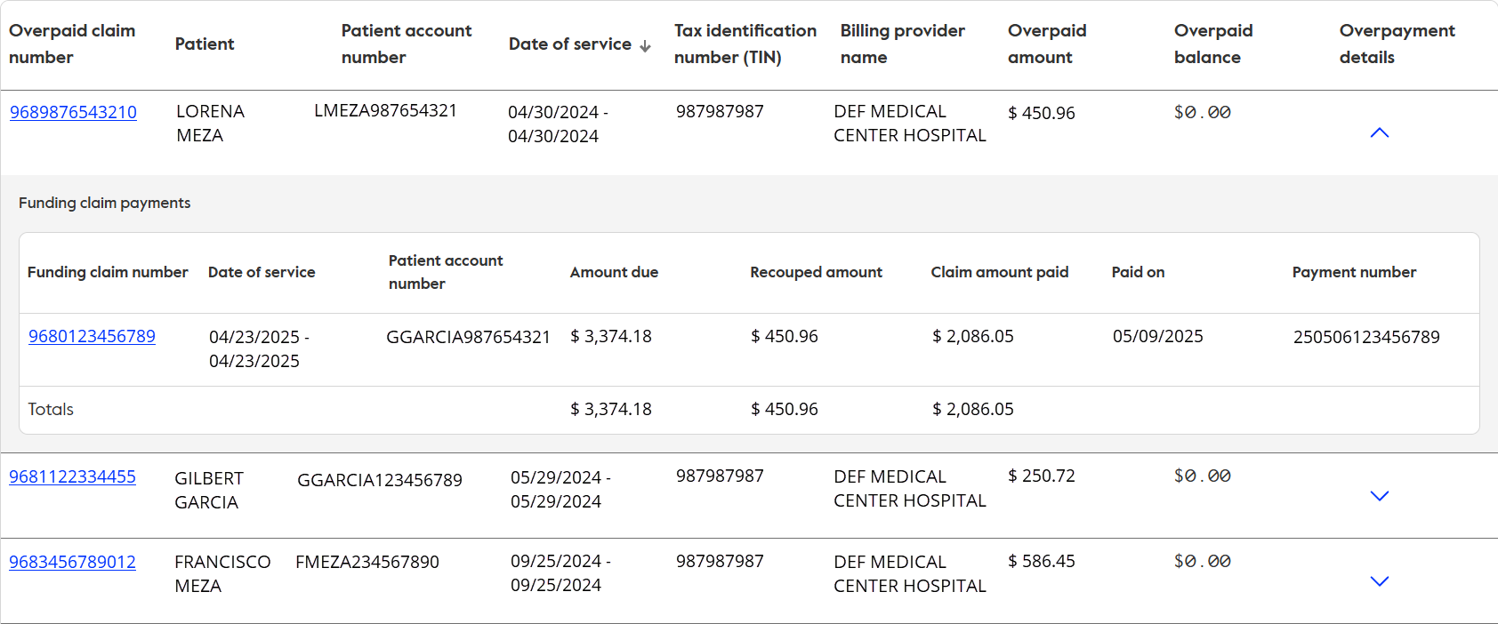
Overpaid and funding claim details
Overpaid claim details
Funding claim
details
Notes:
“This section of the report displays detailed information for both the overpaid claim and the funding claim or check refund used to recover the overpayment.”
“From this view, you can access report details by clicking the downward‑facing caret to the right, to expand the report information.”
“When the report details are expanded, you’ll see a list of all overpaid claims associated with this report.”
“Under each overpaid claim, click the downward‑facing caret to the right to view the related funding claim details.”
“This expanded view helps you understand the relationship between the overpaid claim and the associated funding claim(s) or if a manual payment was applied.

Slide 12

Downloading the report
Notes:
“Next, we’ll review how to download the Negative Balance Report so you can save the results for offline review and reconciliation.”

Slide 13
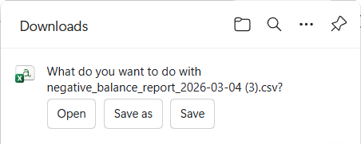
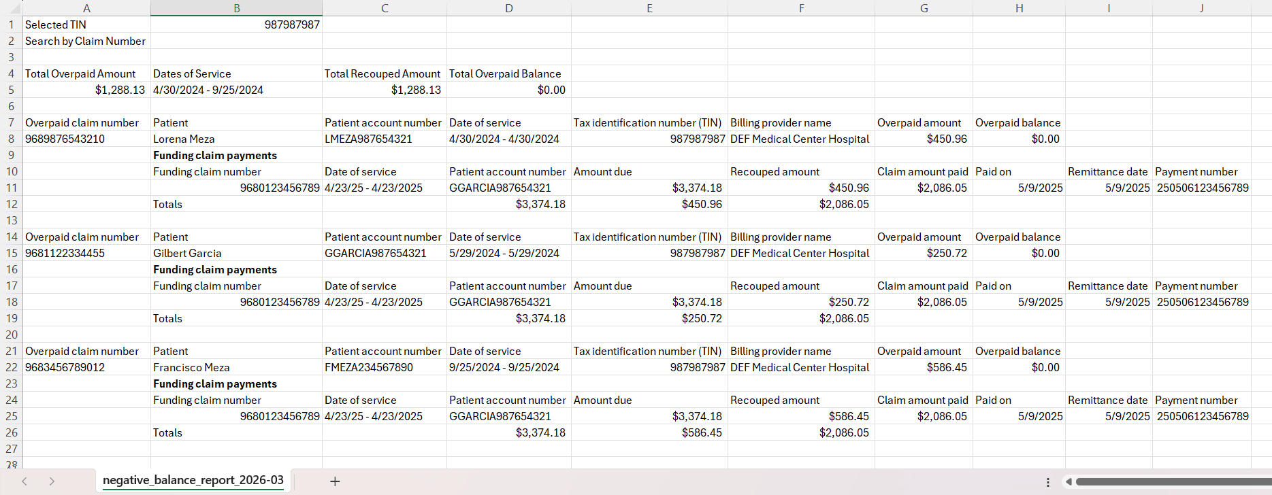
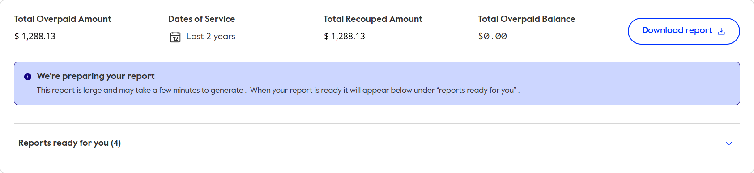
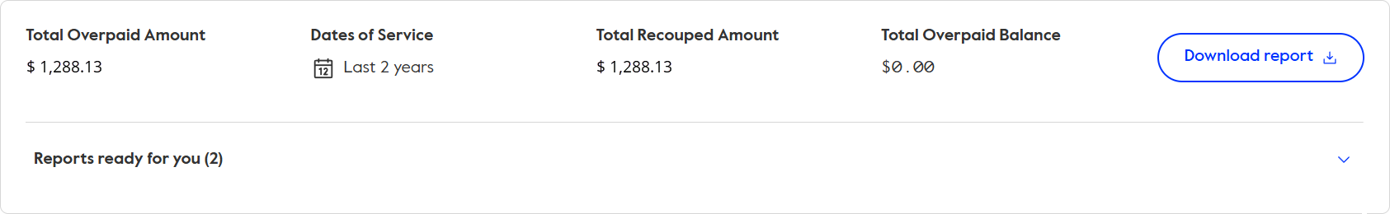
Initial report search
Notes:
“To download the report, start by clicking Download Report on the Negative Balance Report page.”
“Once selected, the report actions will appear in the top right‑hand corner of your screen in your browser’s downloads, allowing you to open the report, save it, or save it as a file for your records.
“Select Open, and the report will open in a CSV format, which you can review and save for your records.”
“If your report is larger, you may see a message that reads ‘We’re preparing your report.’” “When this message appears, the report will be available under Reports Ready for You, which we’ll walk through on the next slide.”

Slide 14
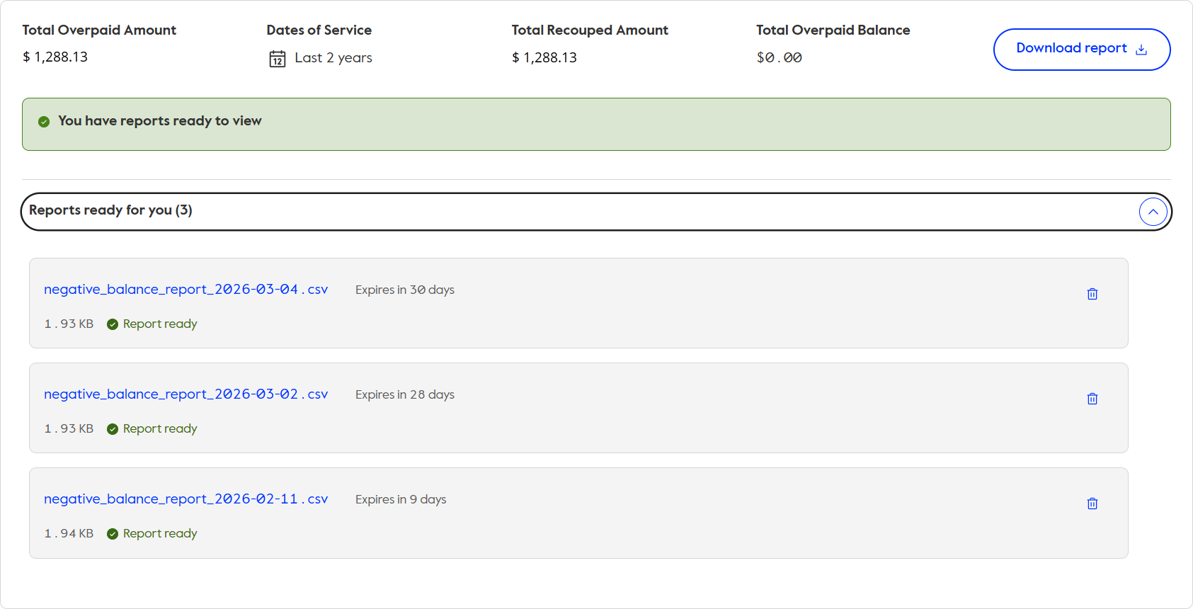
Previously downloaded reports
Notes:
“If your report was still being prepared or you want to review a previously downloaded report, start by selecting Reports Ready for You or click on the downward facing caret where you’ll find reports for the selected TIN that have been downloaded within the last 30 days.
“Reports remain available on the portal for 30 days and are automatically removed after that timeframe.”
“To open a report, click directly on the report name you want to review.”
“Once opened, the report displays the funding claim information, along with all overpaid claims that were recovered using that funding claim.”
“You’ll see the offset amounts applied to each overpaid claim and the final amount paid on the funding claim after the offsets, which supports reconciliation and confirmation of recovery.”

Slide 15
Navigating to the overpaid claim details
Notes:
“Next, we’ll walk through how to navigate from the report directly to the overpaid claim details page so you can review patient and payment information in more detail.”

Slide 16
Linking to additional claim details
Notes:
“From the Negative Balance Report, you can link directly to either the overpaid claim or the funding claim to review additional claim details.
This link takes you to the funding claim detail page, which we’ll walk through in more detail in the next section.
And this link opens the overpaid claim detail page, where you can review the related claim and payment information.”

Slide 17
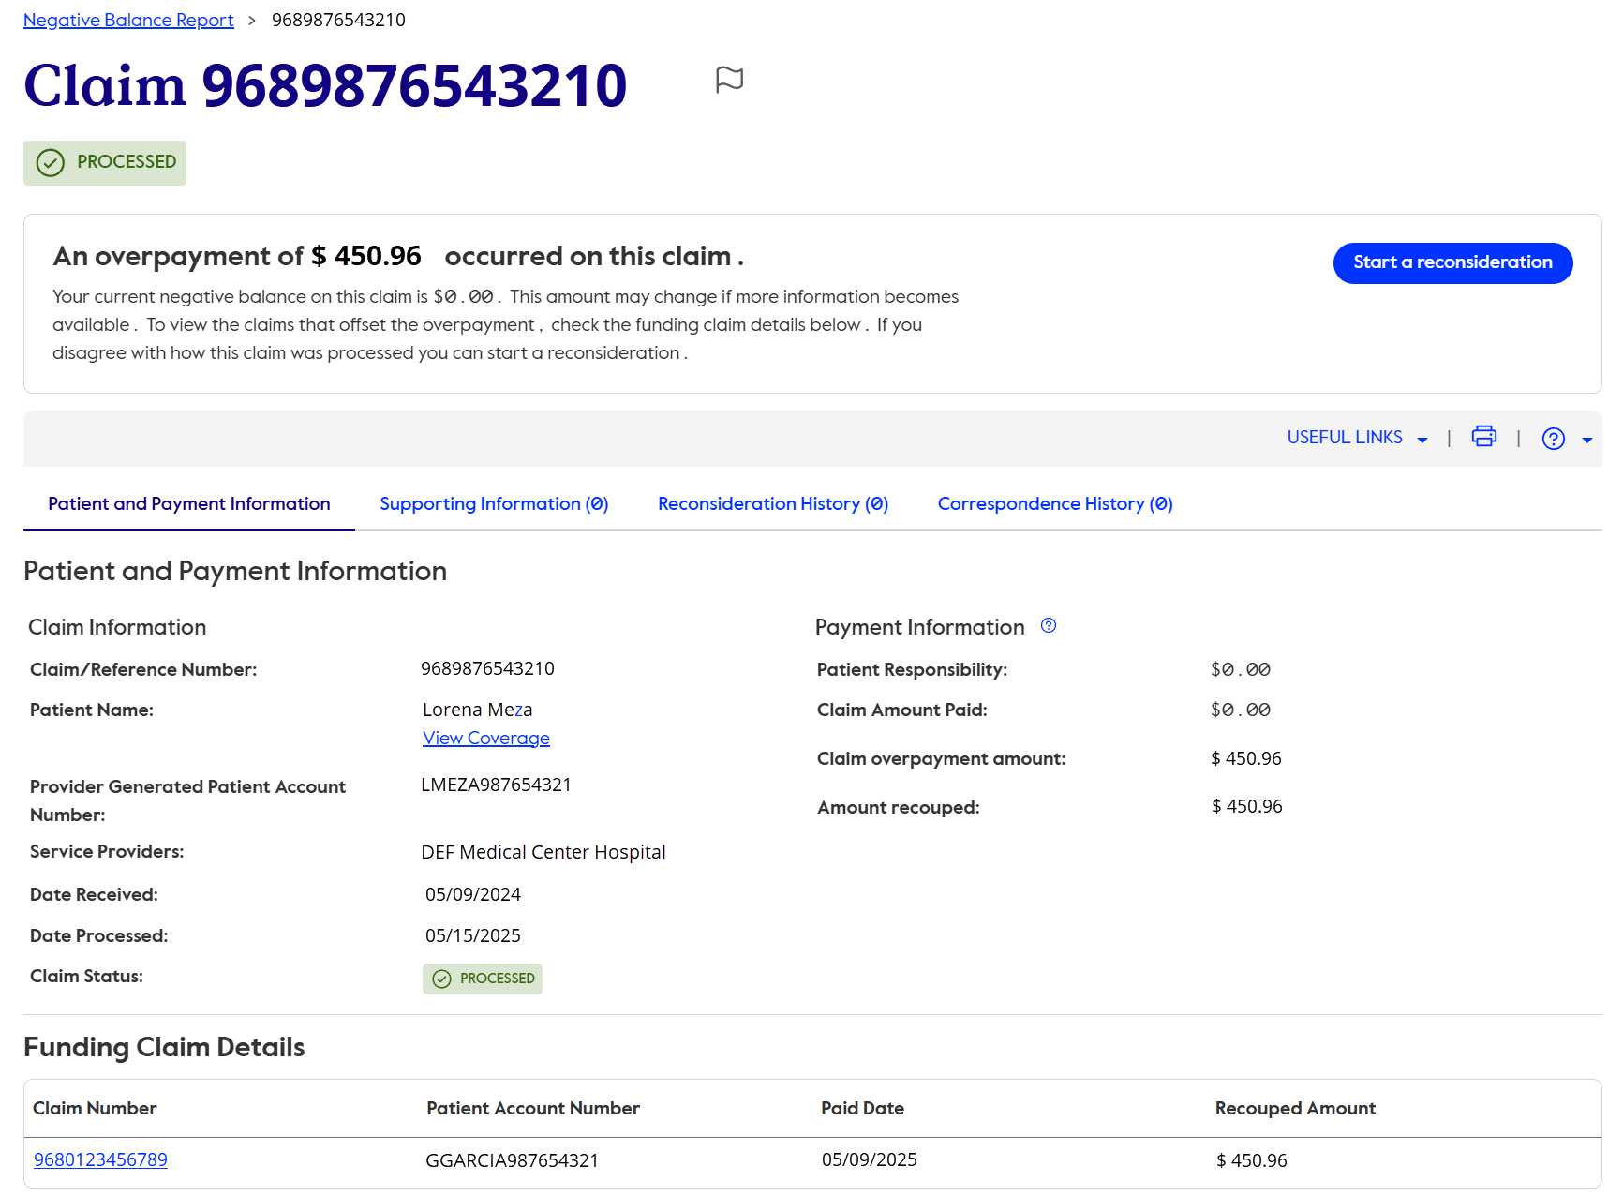
Overpaid claim detail page
Submit a reconsideration
Recouped amount
Click to go to the funding claim detail page
Notes:
“On the overpaid claim detail page, start by looking at the banner at the top of the screen, which highlights the overpaid amount and shows whether the balance is still outstanding, has been recovered through an auto recoupment (also known as a claim offset) applied to a funding claim, or has been resolved by a check you’ve submitted.”
Just below, in the payment information section, you’ll see the original overpayment amount and, beneath it, the amount that has been recouped, as shown in this example.
If you disagree with the overpayment determination, you can submit the claim for reconsideration directly from this page.
Using the breadcrumb trail in the top left corner, you can easily navigate back to the Negative Balance Report at any time.
And from here, you can also link directly to the funding claim detail page to review how the offset was applied.
This bi‑directional navigation between the overpaid and funding claims helps support clear, accurate accounts receivable reconciliation.”

Slide 18
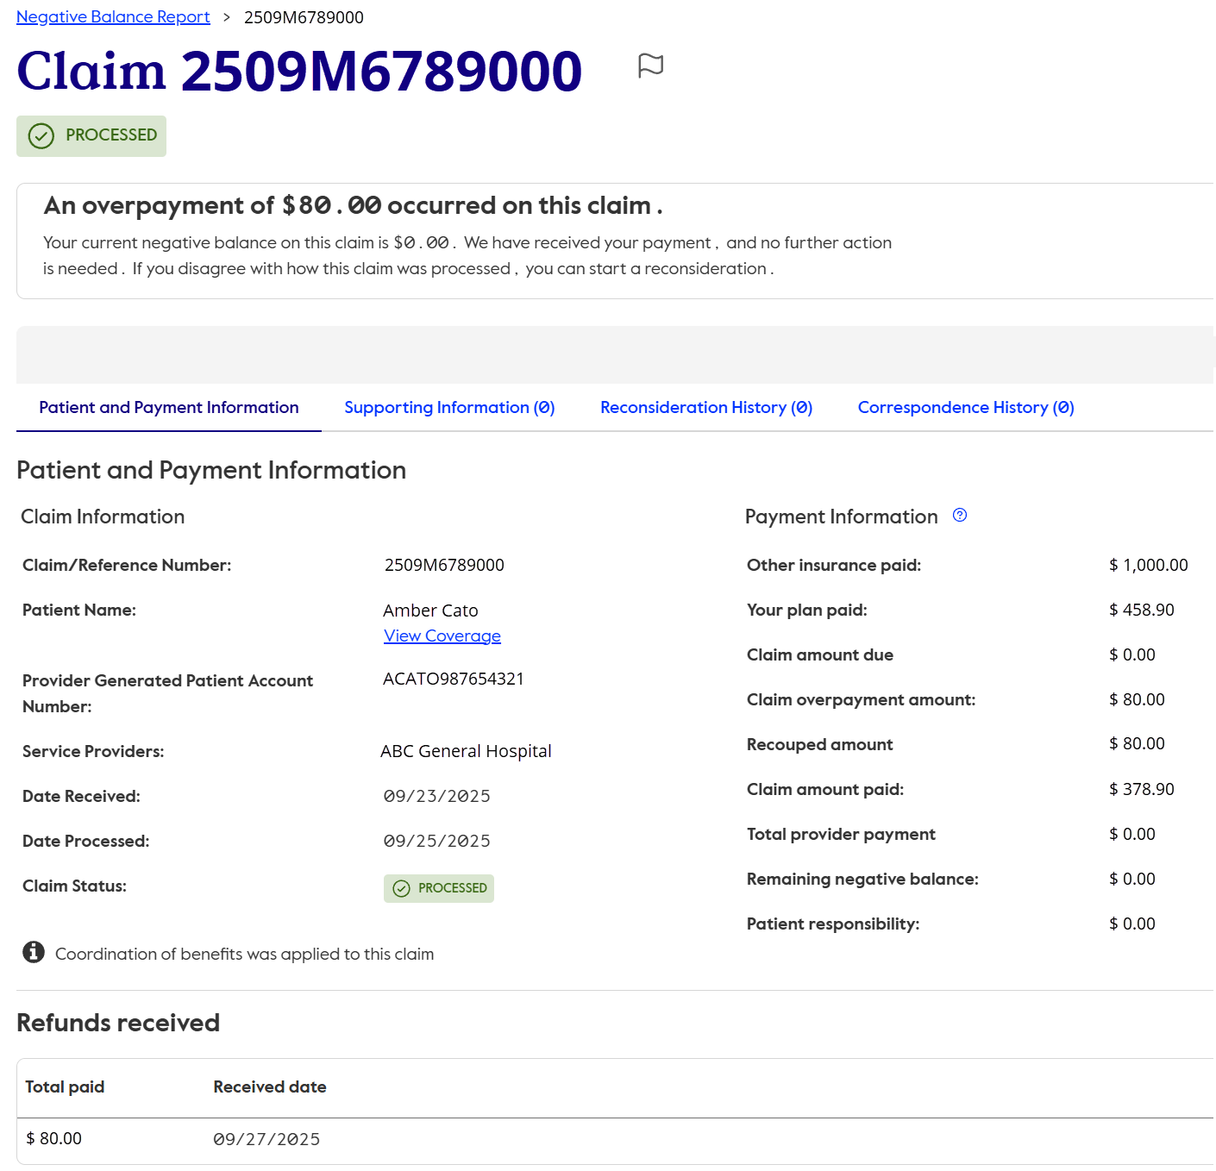
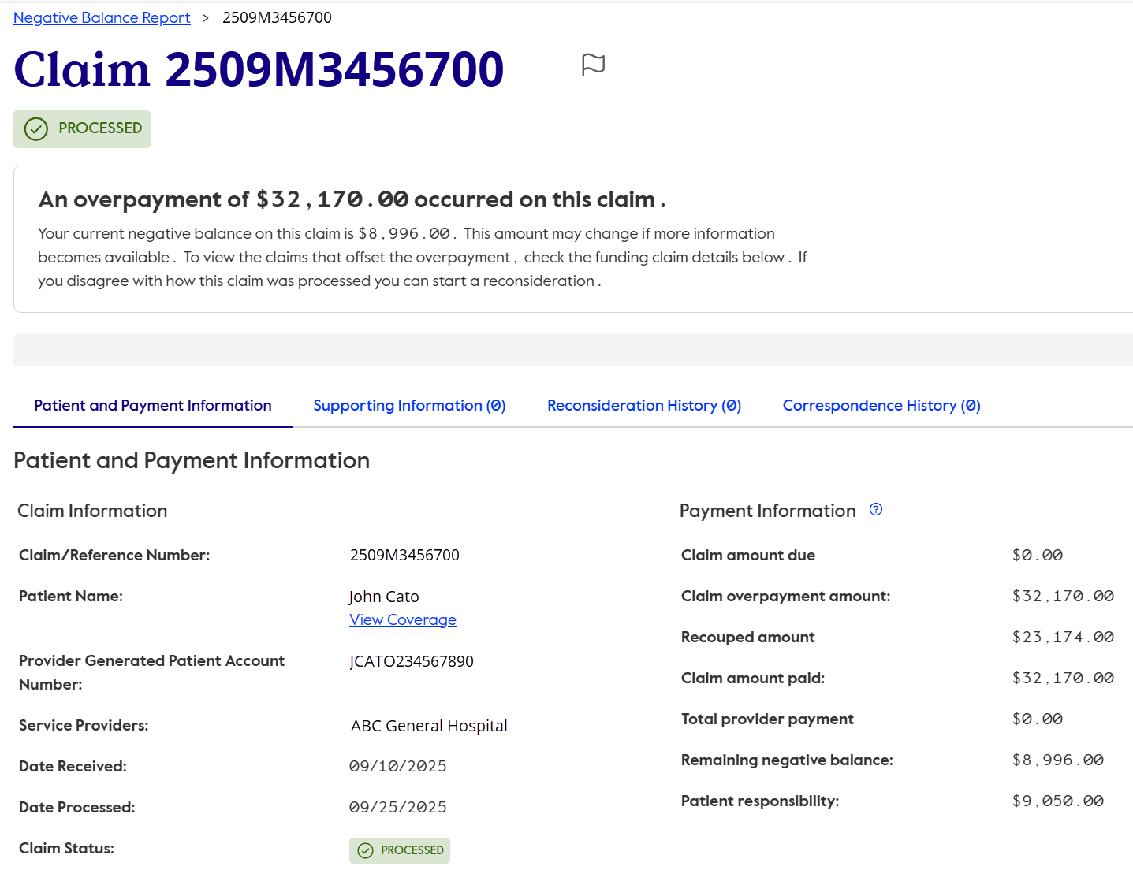
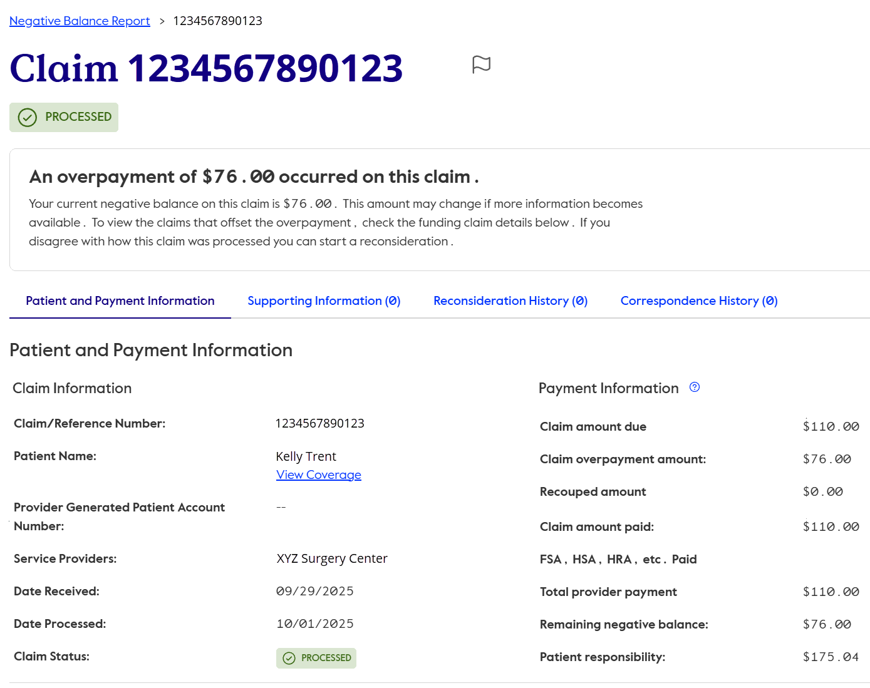
Banner messages on overpaid claims
Notes:
“On this slide, we’ll review additional banner messages you may see on overpaid claims. These banners give you a quick, at‑a‑glance status of the overpayment and tell you whether any action is still needed.”
“This first banner, on the top, confirms the overpayment has already been refunded in full. When you see this message, no further action is needed.”
“The second banner, in the middle, shows an overpayment that has been partially recovered through a payment offset. It also clearly displays the remaining balance that is still due, so you know additional recovery is pending.”
“The third banner, on the bottom, indicates the overpayment has not yet been recovered. This means the balance is still outstanding and may require a refund or future offset.”

Slide 19
Overpaid claim details page with banners
000
This section shows refunds received by check, including the check amount and receipt date.
Shows the overpayment has not yet been fully refunded
Overpayment balance is still pending refund.
Notes:
Now lets take a look at the claim details for those additional banner messages.
“In the first example, the banner shows that the overpayment was satisfied by a check refund. This confirms the refund has been received and no additional recovery is needed.”
“The next example shows an overpayment that was partially recovered through an auto recoupment. The banner clearly indicates that a remaining balance is still due, so additional recovery is pending.”
“In the final example, the claim has been identified as overpaid, but no recovery has occurred yet. This banner lets you know the overpayment is waiting for reimbursement.”
Key takeaways
“These banner messages help you quickly understand the current status of an overpayment—whether it’s been refunded, partially recovered, or still outstanding—so you know what, if any, action is needed.”

Slide 20

Linking overpaid claims to funding claim details
Notes:
“Now we’ll connect the dots by showing how to move between the overpaid claim and the funding claim, so you can clearly see how the offset was applied and confirm the overpayment has been resolved.”

Slide 21
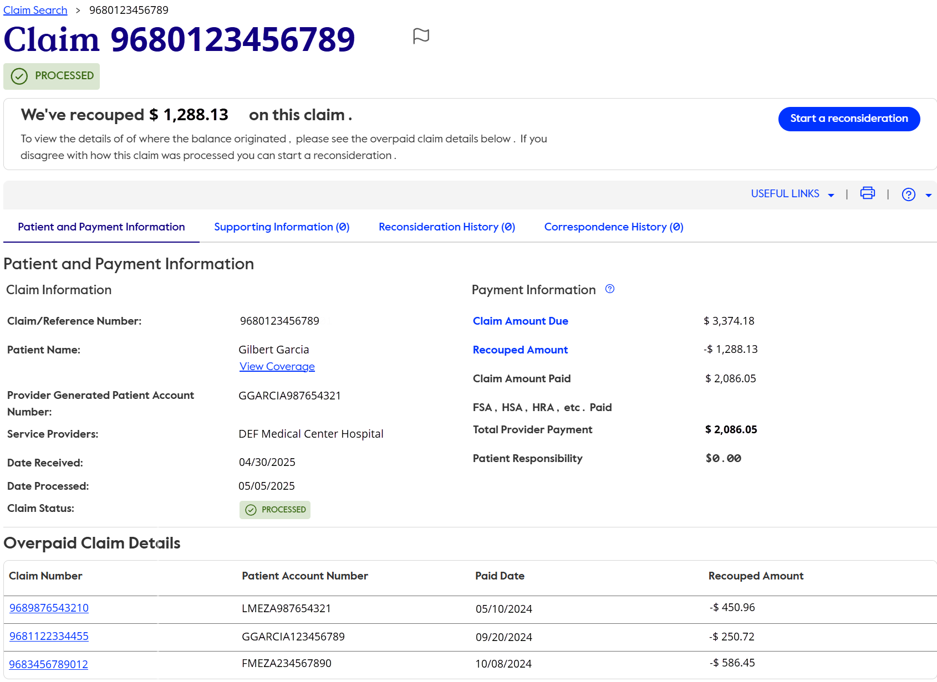
Funding claim
Claim amount due
Recouped and funding claim payment amounts
Payment amount
Select the claim number to view the overpaid claim details.
Notes:
“From the overpaid claim detail page, select the funding claim link to review how the offset was applied.”
“On the funding claim page, a banner at the top confirms that an offset has already occurred.”
“Below the banner, you’ll see the original payment amount,
the amount offset,
and the net payment after recoupment, giving you clear visibility into the adjustment.”
“As you scroll down, you can also review the overpaid claims that were recovered using this funding claim.”
“Together, the Negative Balance Report, overpaid claim, and funding claim pages help you confirm whether an overpayment has been fully recovered, partially recovered, or is still outstanding.”

Slide 22
Summary and key takeaways
Notes:
“Now that we’ve walked through how to find, review, and navigate the Negative Balance Report, let’s pause to summarize the key takeaways you can use to support accurate and efficient reconciliation.”

Slide 23
Recap
Summary
The Negative Balance Report helps providers quickly confirm when an overpayment has been resolved – either through a payment offset or a manual refund – which clearly links that activity directly to the related overpaid and funding claims.
What you need to know
Use the Negative Balance Report to confirm overpayments already recovered, so you know no additional payment is expected or still outstanding.
Search results by TIN, with options to refine by claim number and date of service.
Download the report as a CSV file, available for 30 days, to support offline review and reconciliation.
Navigate between the overpaid claim and funding claim to review patient and payment details without searching multiple areas of the CignaforHCP.com.
Review banner messages on the overpaid claim detail page to quickly understand the status of an overpayment (refunded, partially recovered, or outstanding).
Notes:
“Use the Negative Balance Report to confirm overpayments that have already been recovered, so you know no additional payment is expected.”
“Search results by Tax Identification Number, with options to refine by claim number and date of service, to quickly locate overpayment activity.”
“Download the report as a CSV file, available for 30 days on the portal, to support offline review and internal reconciliation.”
“Navigate between the overpaid claim and the funding claim to review patient and payment details without searching multiple areas of the portal.”
“Review banner messages on the overpaid claim detail page to quickly understand the status of an overpayment—refunded, partially recovered, or still outstanding.”
“Together, these tools are designed to save time, reduce manual research, and support accurate, confident reconciliation. Thank you for taking the time to walk through the Negative Balance Report—I hope this helps make your day‑to‑day review a little easier.”

Slide 24
Cigna Healthcare products and services are provided exclusively by or through the operating subsidiaries of The Cigna Group.
PCOMM-2026-206 04/26 © 2026 Cigna Healthcare. Some content provided under license.

